Slide 1
Designing Sustainable Landscapes for Avian Conservation in the SAMBI area

Slide 2
Presentation Outline
Project overview and objectives
Identifying conservation priorities
Identification of focal species
Calculating priorities
Selecting focal areas
Input from Management Board
Availability & application of data
Related project
Optimal Conservation Strategies

Slide 3
Project overview and objectives

Slide 4

Funding and Cooperation
Funding
Multistate Conservation Grant
USGS Gap Analysis Program
USGS Science Support Project (Development of Inference Methods)
USFWS ACJV
Cooperators
NC Cooperative Fish & Wildlife Research Unit
AL Cooperative Fish & Wildlife Research Unit
Atlantic Coast Joint Venture

Slide 5
Project Goal
Develop methodology and enhance the capacity of states, joint ventures and other partners to assess and design sustainable landscape conservation for birds and other wildlife in the eastern United States.
Notes:
Specifically, this project would develop and implement a framework and tools to…

Slide 6
Project Objectives
Assess the current capability of landscape to support bird populations
Predict the impacts of landscape-level changes (e.g., from urban growth, conservation programs, climate change)
Target conservation programs to effectively and efficiently achieve objectives
Enhance coordination among partners during the planning, implementation and evaluation of habitat conservation through conservation design
Notes:
The overall objective of this proposal is to develop a consistent methodology and to enhance the capacity of states, joint ventures and other partners to assess and design sustainable landscape conservation for birds and other wildlife in the eastern United States. Specifically…

Slide 7
Collaborative approach
Landscape dynamics – 100yrs (NC CFWRU & BaSIC)
Climate change (3 Scenarios)
Sea level rise (3 Scenarios)
Urbanization (1 Scenario)
Identification of focal species (ACJV & AL CFWRU)
Potential habitat for priority birds (NC CFWRU & BaSIC)
Modeling conservation priorities (AL CFWRU)
Delineating focal areas (ACJV & AL CFWRU)

Slide 8
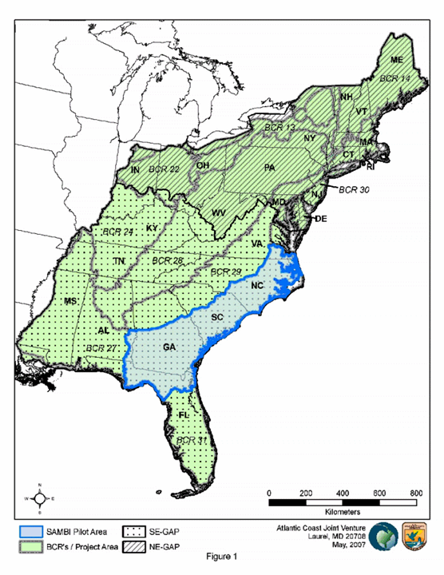
Project Extent
Pilot Area:
South Atlantic Migratory Bird Initiative
12 Priority habitats
Potential Expansion
SE-GAP Project area
NE-GAP Project area

Slide 9
Identifying conservation priorities

Slide 10
Approach
Select focal species for each habitat
Potential habitat*
Source populations*
Suitable sites for each habitat*
Landform
Geographic constraints
Constraints on management/restoration*
Long-term commitment
* Affected by landscape dynamics

Slide 11
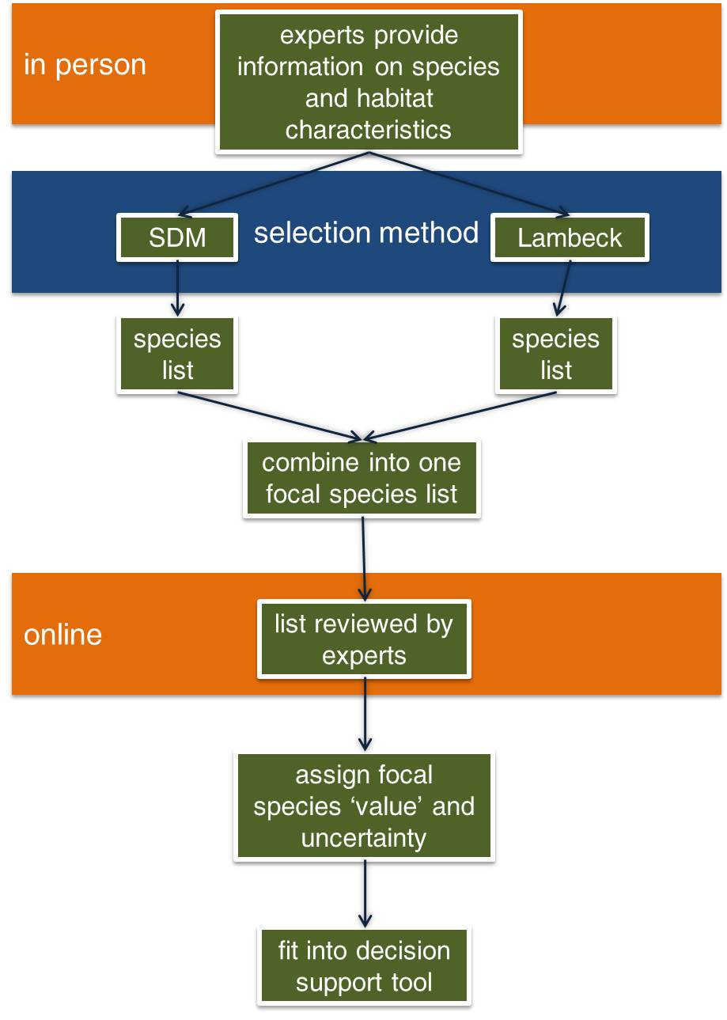
Identification of focal species

Slide 12
Focal species
Both methods | SDM only | Lambeck only
American black duck | Nelson’s sharp-tailed sparrow | Lesser scaup
Wood duck | Least bittern | Black scoter
Redhead | Least tern | Canvasback
Swallow-tailed kite | Black skimmer | Cerulean warbler
Red-headed woodpecker | Sandhill Crane | Chuck-will’s widow
Red-cockaded woodpecker | Prothonotary warbler | Swainson’s warbler
Loggerhead shrike | Northern pintail | Painted bunting
Common ground dove | Black-throated green warbler | Prairie warbler
American oystercatcher | Wood stork | Northern bobwhite
Red knot | Brown-headed nuthatch | Henslow’s sparrow
 | Summer tanager | American kestrel
 | Swallow-tailed kite | Bachman’s sparrow
 |  | Wilson’s plover
 |  | Piping plover
 |  | Whimbrel

Slide 13
Focal species
Acadian flycatcher
American black duck
American black duck
American kestrel
American oystercatcher
Bachman's sparrow
Black-throated green warbler
Brown-headed nuthatch
Cerulean warbler
Chuck-will's-widow
Common ground dove
Field sparrow
Henslow's sparrow
Hooded warbler
Kentucky warbler
King rail
Least bittern
Least tern
Loggerhead shrike
Louisiana waterthrush
Nelson's sharp-tailed sparrow
Northern bobwhite
Northern pintail
Northern parula
Painted bunting
Piping plover
Prairie warbler
Prothonotary warbler
Red-cockaded woodpecker
Red-headed woodpecker
Redhead
Redknot
Saltmarsh sharp-tailed sparrow
Sandhill Crane
Seaside sparrow
Summer tanager
Swainson's warbler
Swallow-tailed kite
Wood duck
Wood duck
Wood stork
Yellow-throated warbler
Notes:
green species are wintering species

Slide 14
Calculating priorities

Slide 15
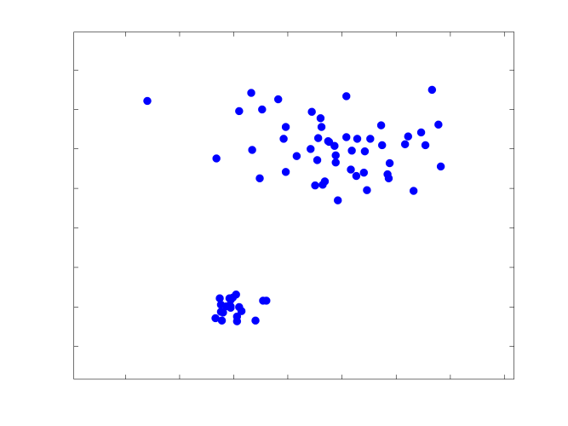
Resource Density
Nearer to larger patches = ⬆ DENSITY
When density of resources is higher
Patch size is larger
Distance to resources is smaller
Cost of enlarging patches is lower
Connectivity is greater

Slide 16

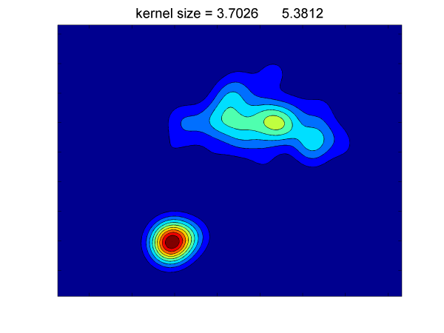
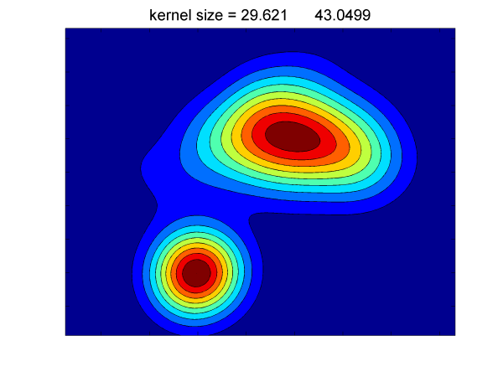
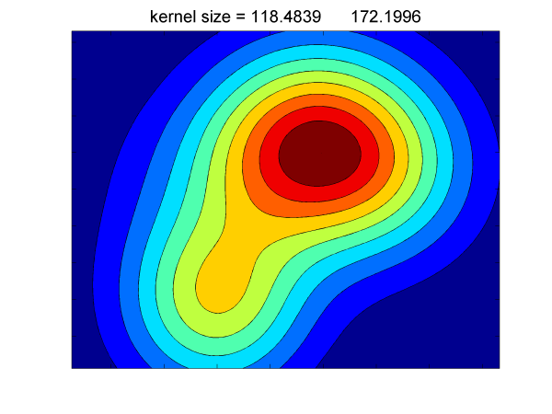
Kernel size

Slide 17
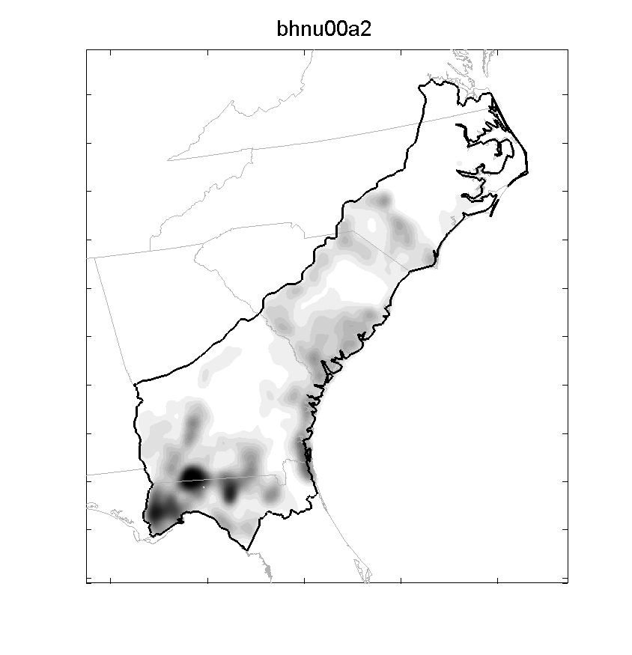
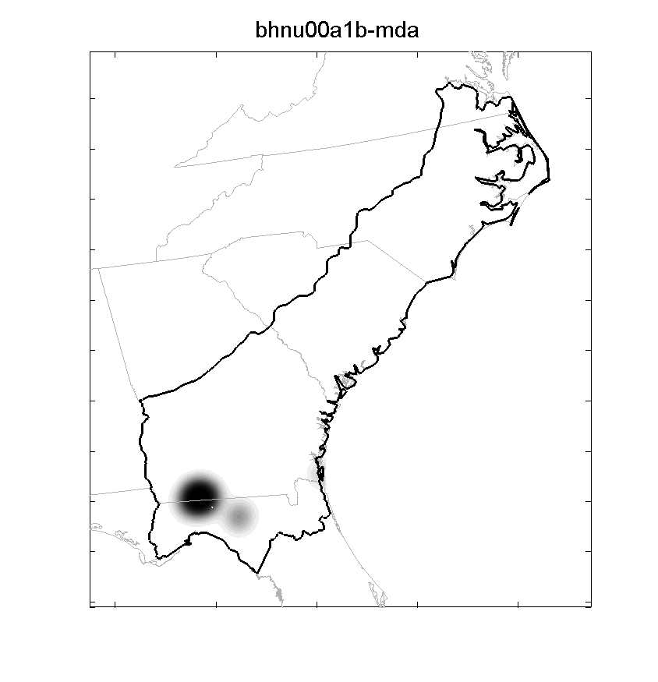
Species-specific data
Potential habitat
Potential source populations

Slide 18
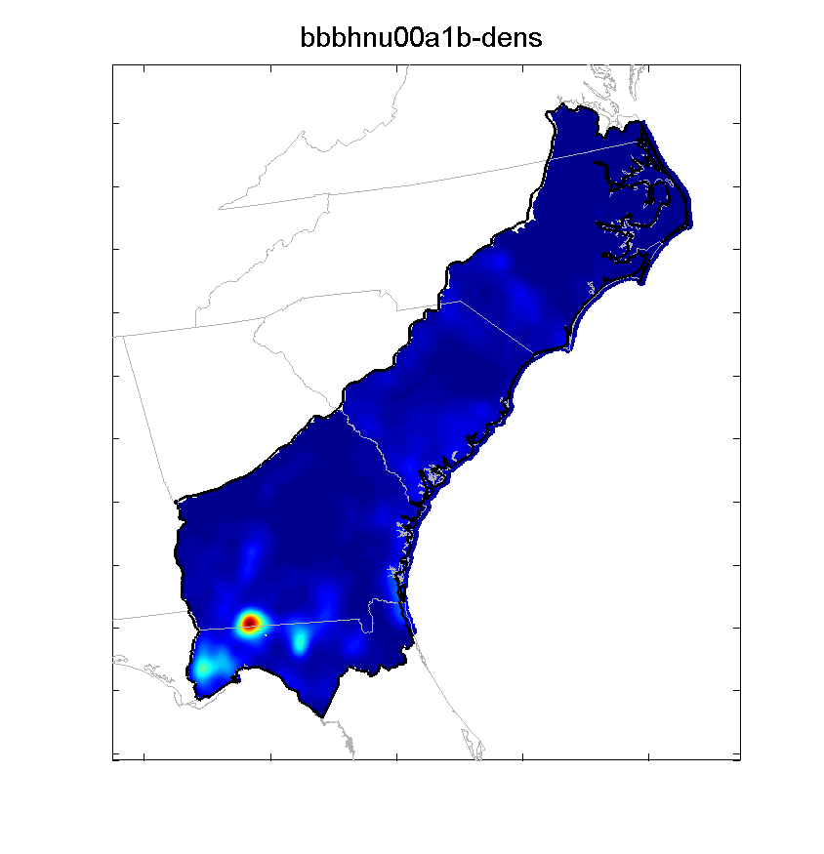

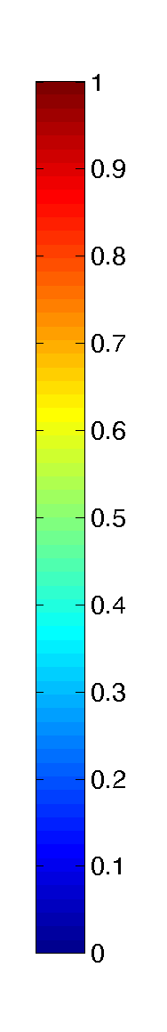
Species-specific data
Potential habitat
Potential source populations

Slide 19
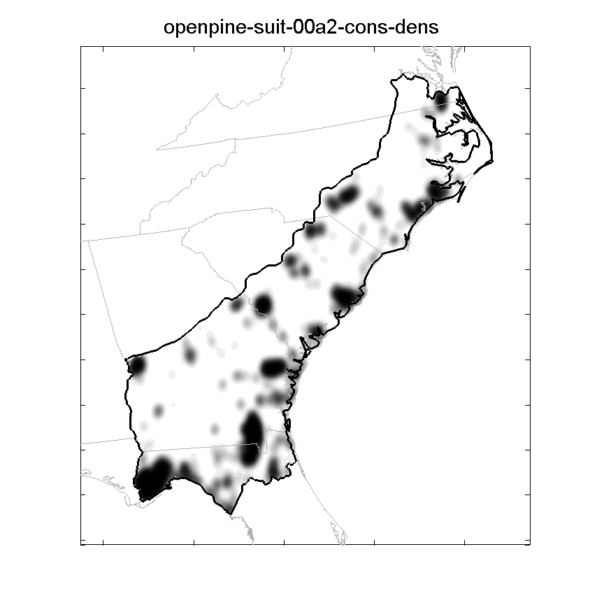
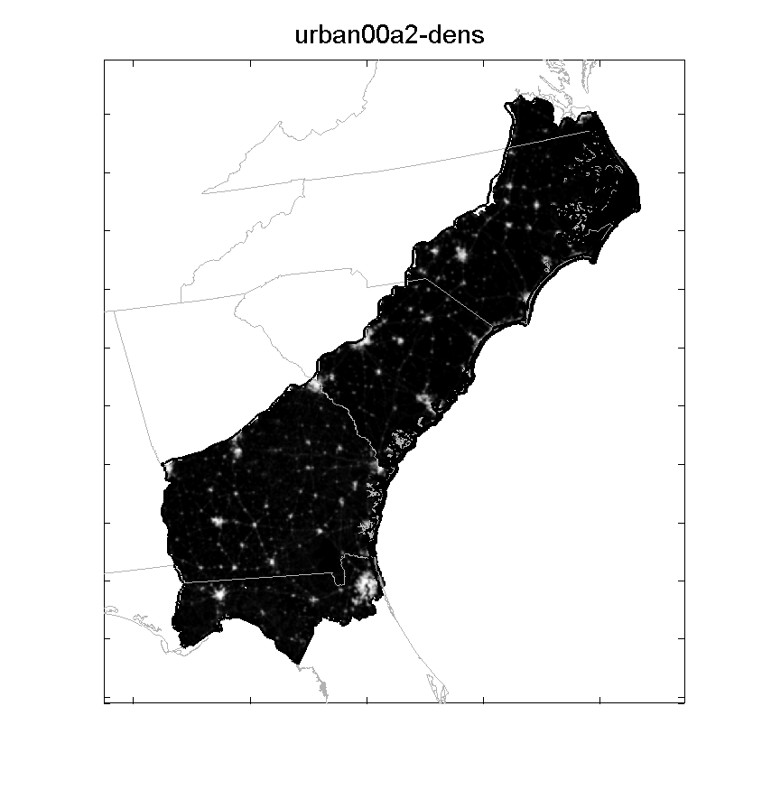
Habitat-specific data
Suitable sites
Conservation estate
Management potential

Slide 20
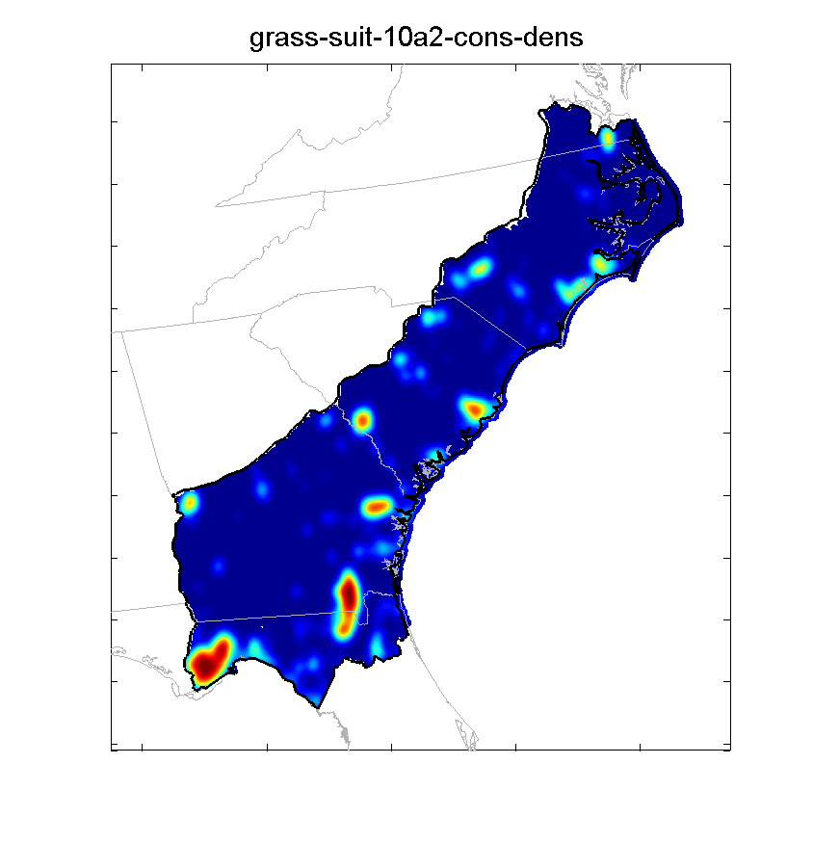
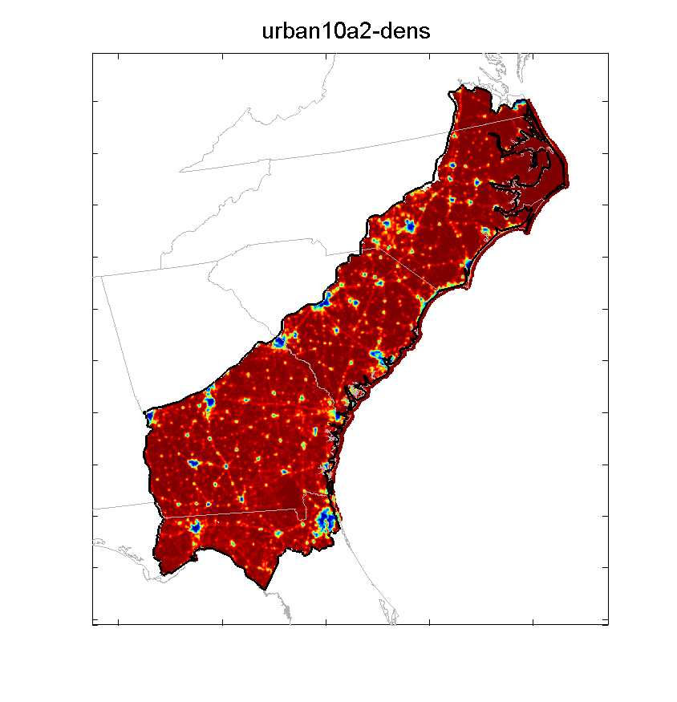
Habitat-specific data
Suitable sites
Conservation estate
Management potential

Slide 21
Priority model
Combine densities to assign priority
Limiting factors (*)
Density of suitable sites for habitat x (S)
Potential to manage (F)
Compensatory factors (+)
Density of source populations (P)
Density of conservation estate (L)
Density of potential habitat (H)
Priority = S*F*(P+L+H)

Slide 22
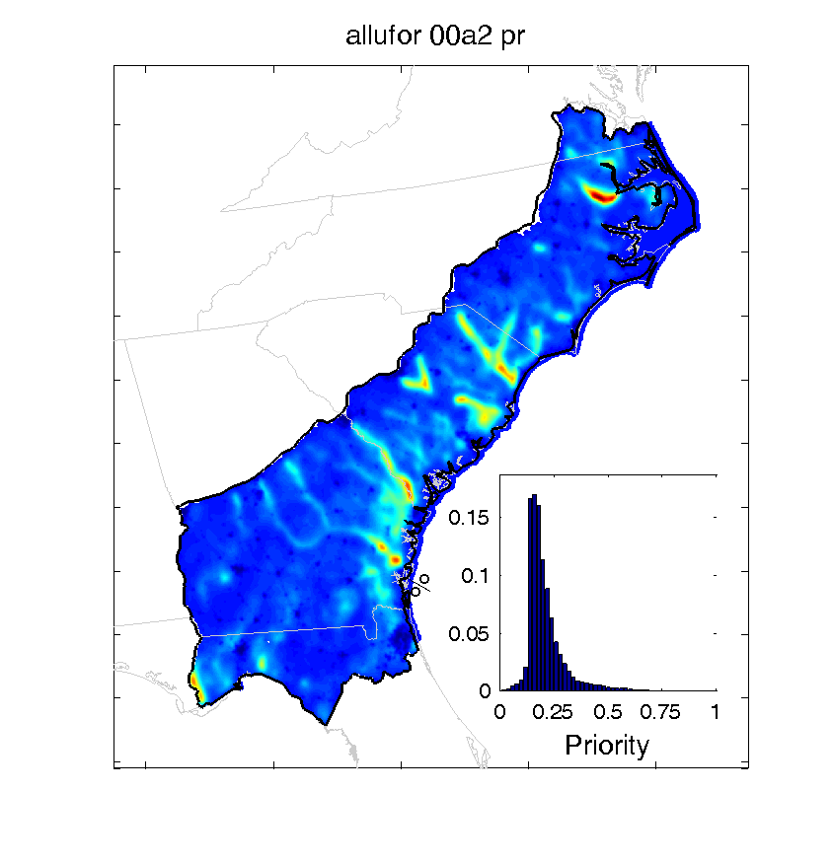
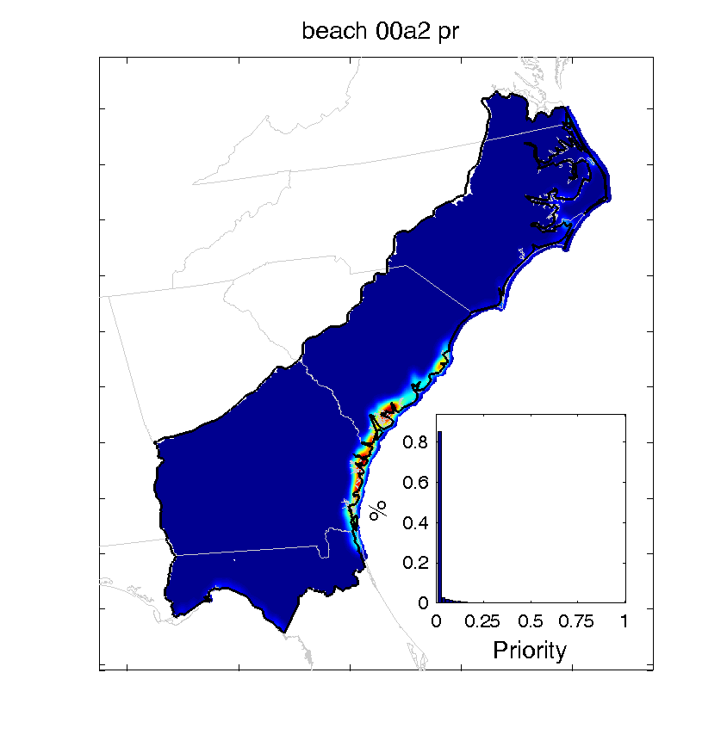

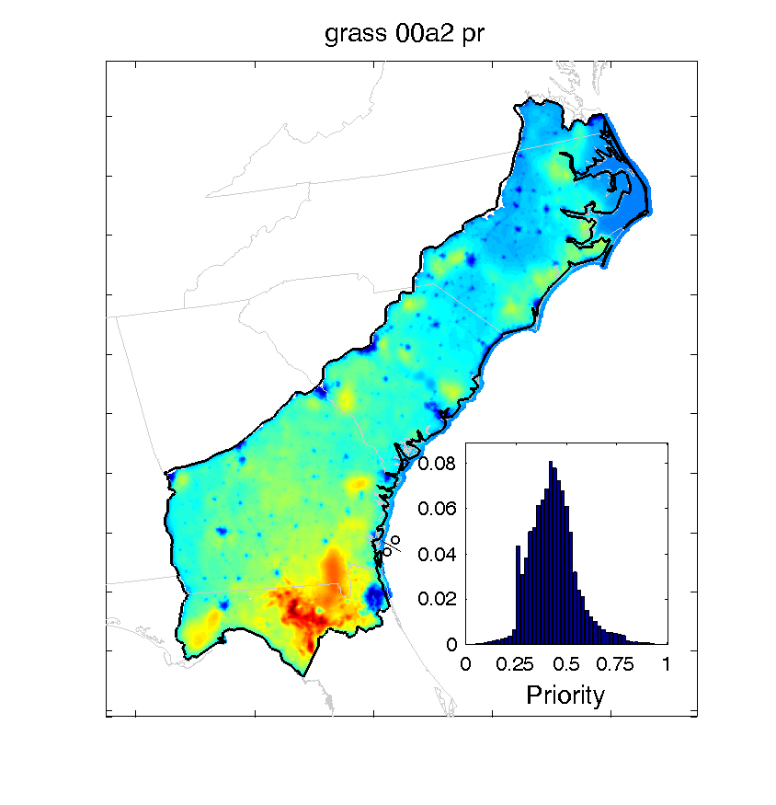
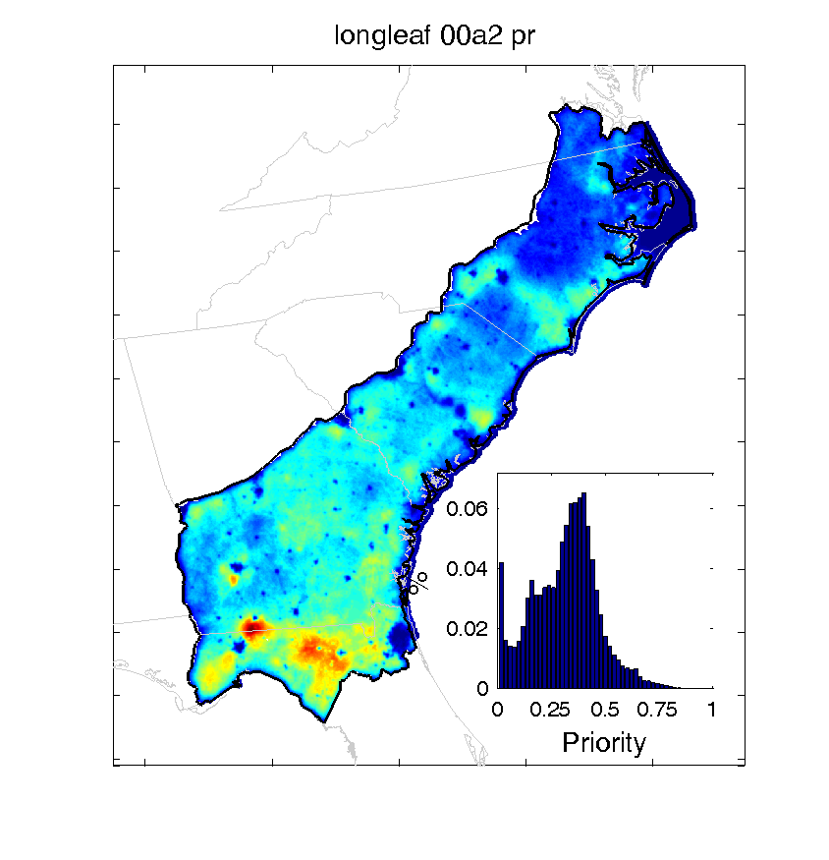

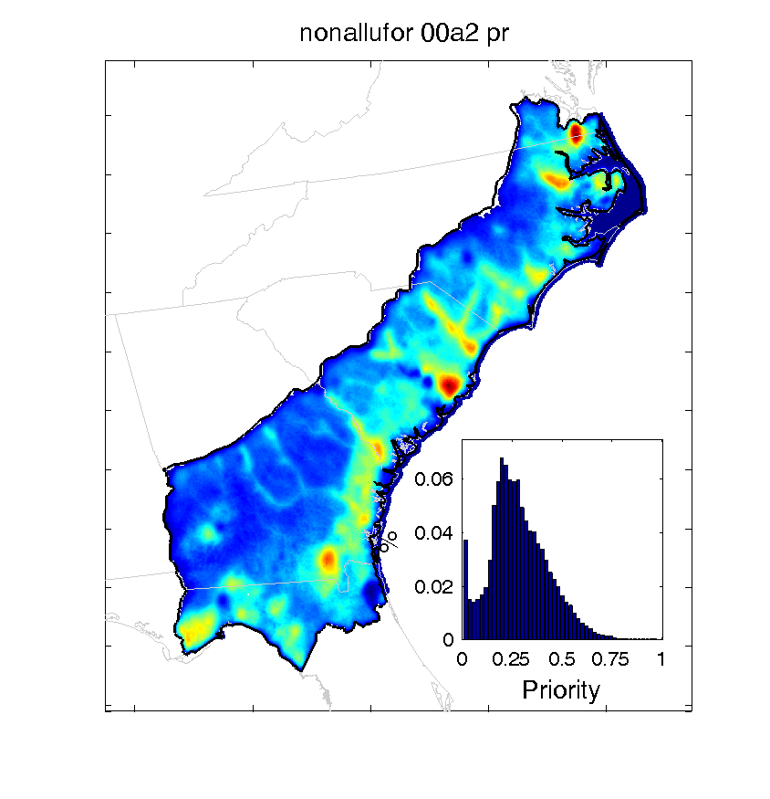
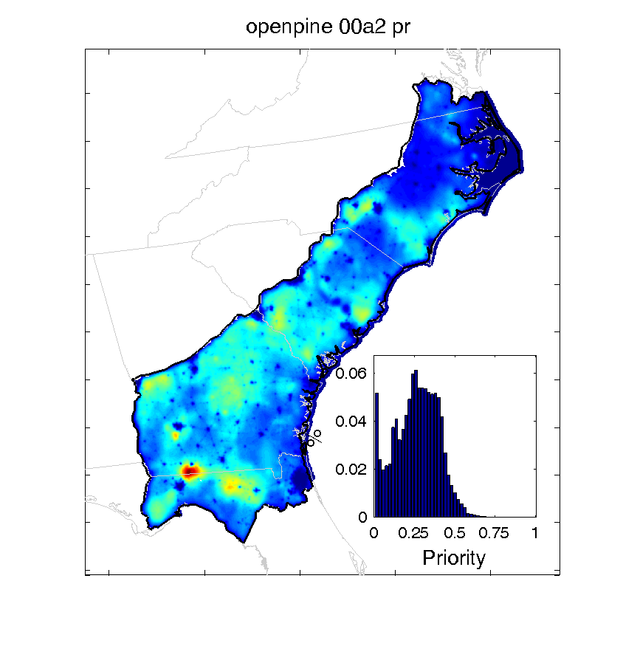
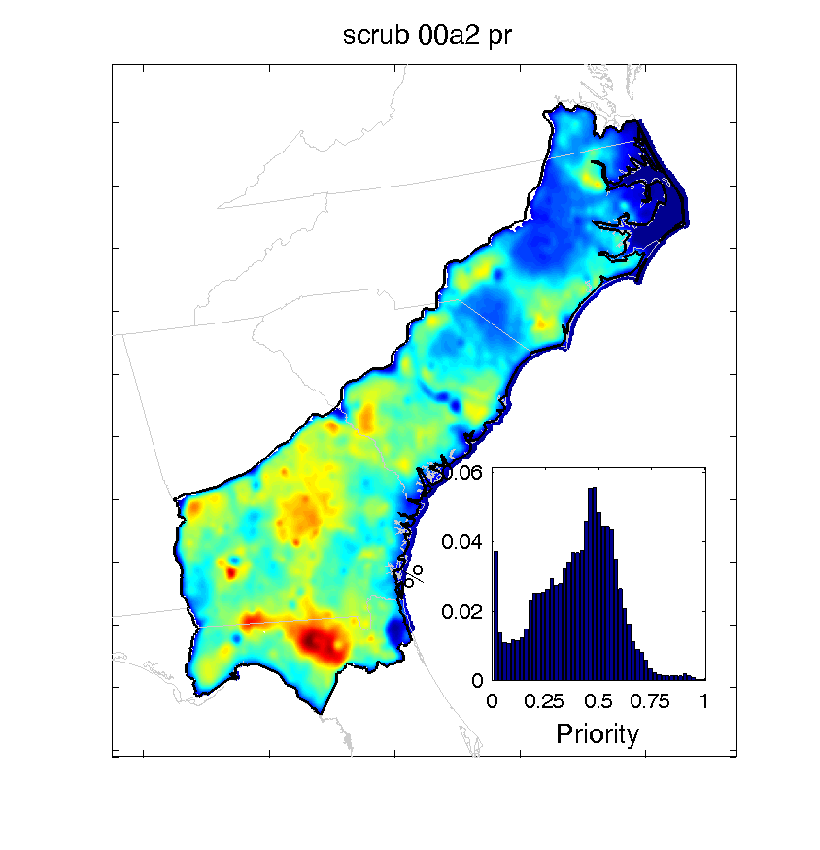
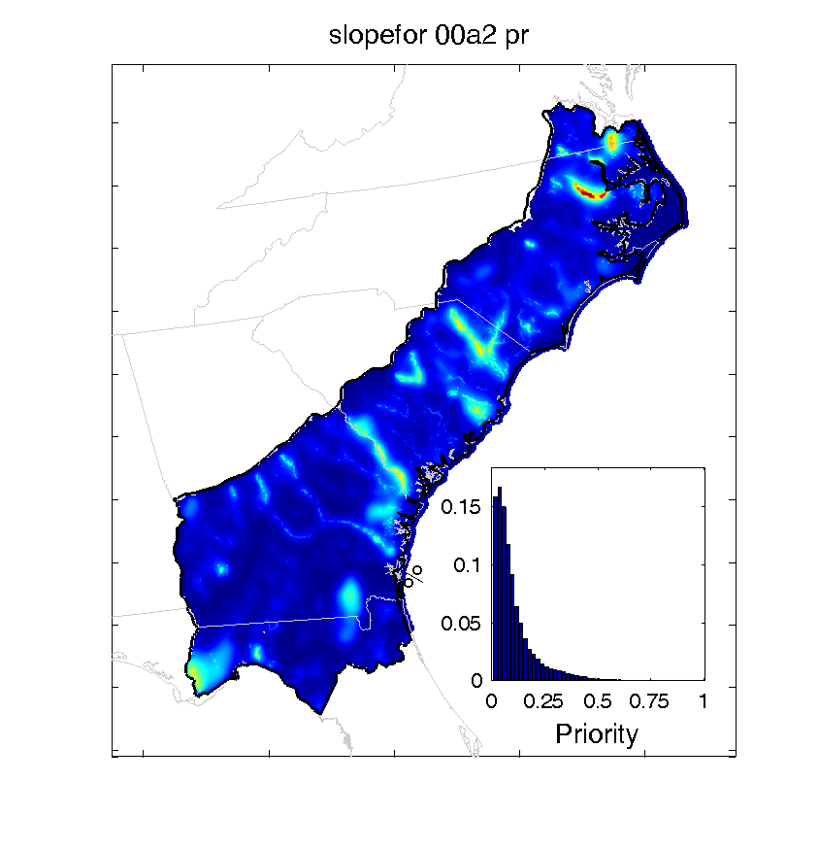
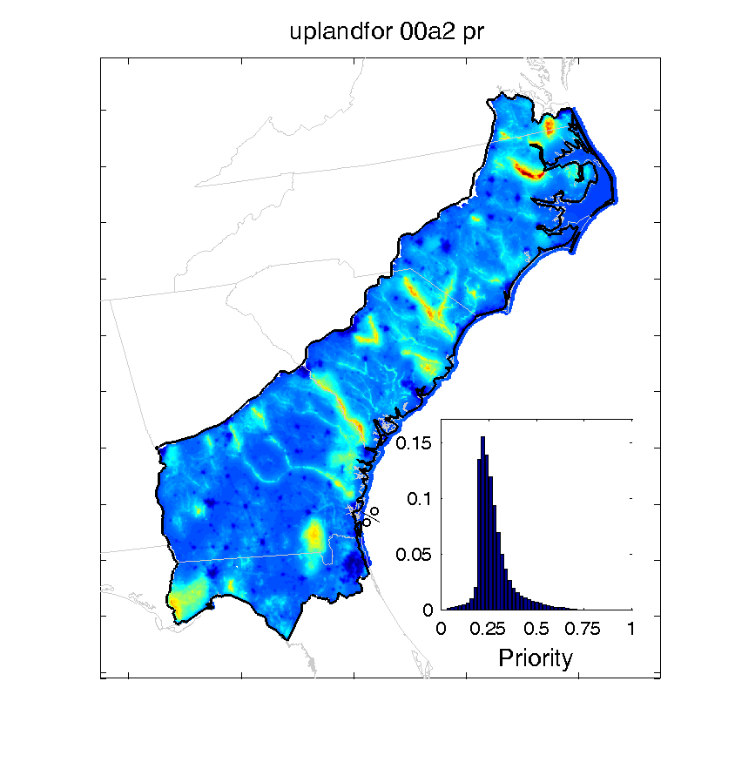
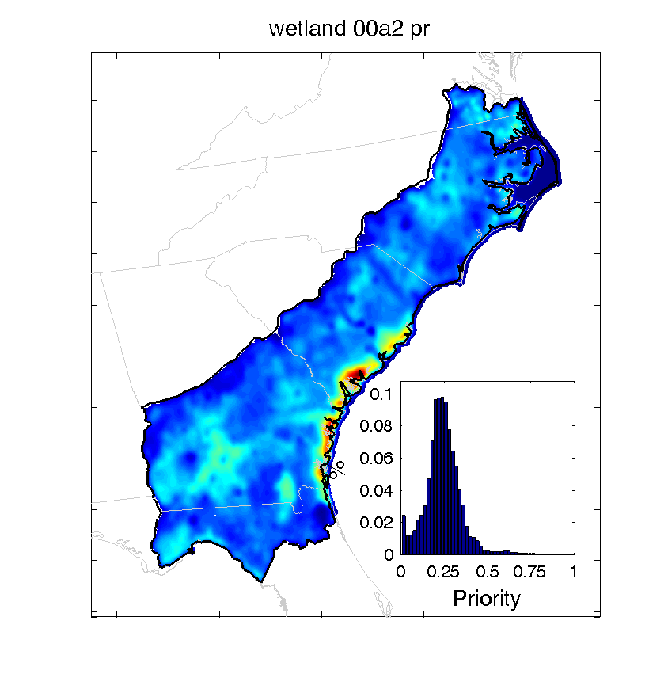
Habitat priorities

Slide 23

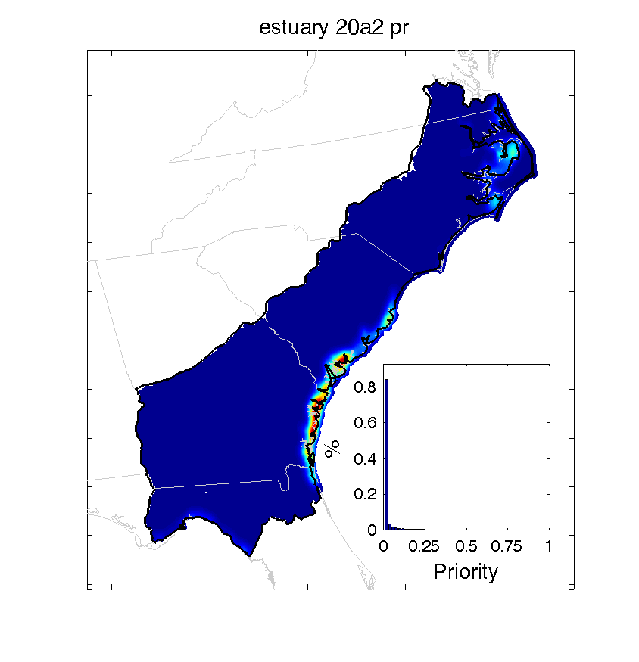









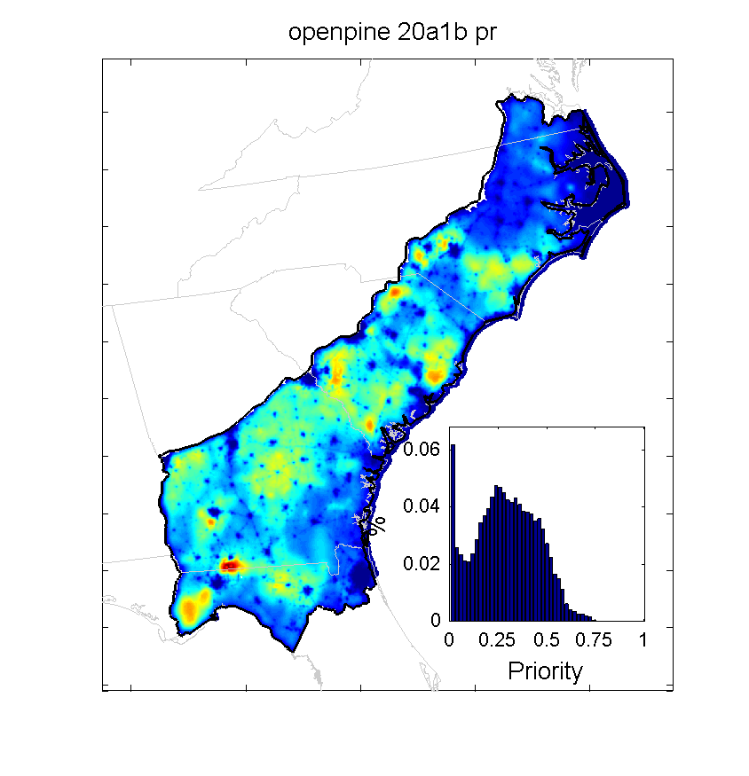
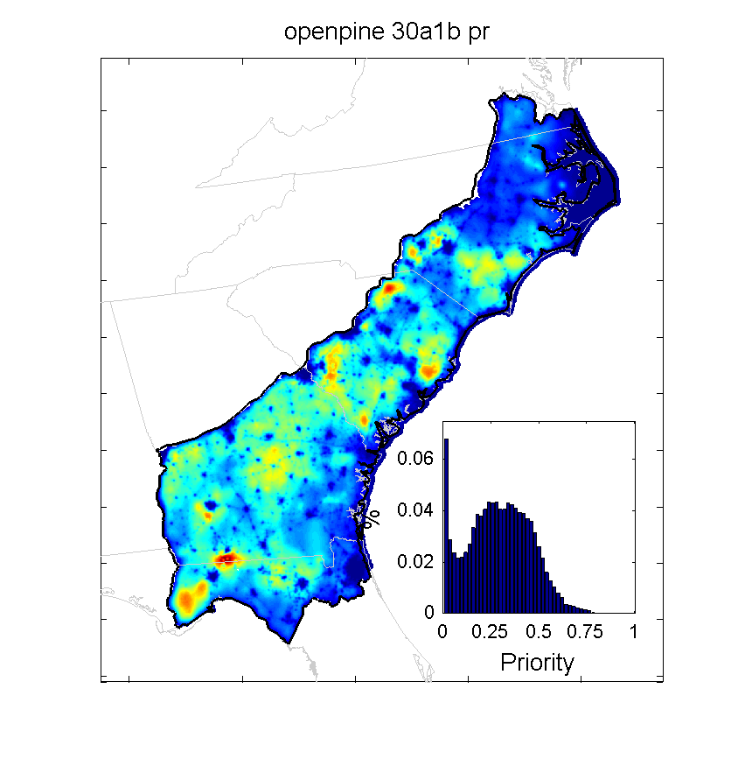

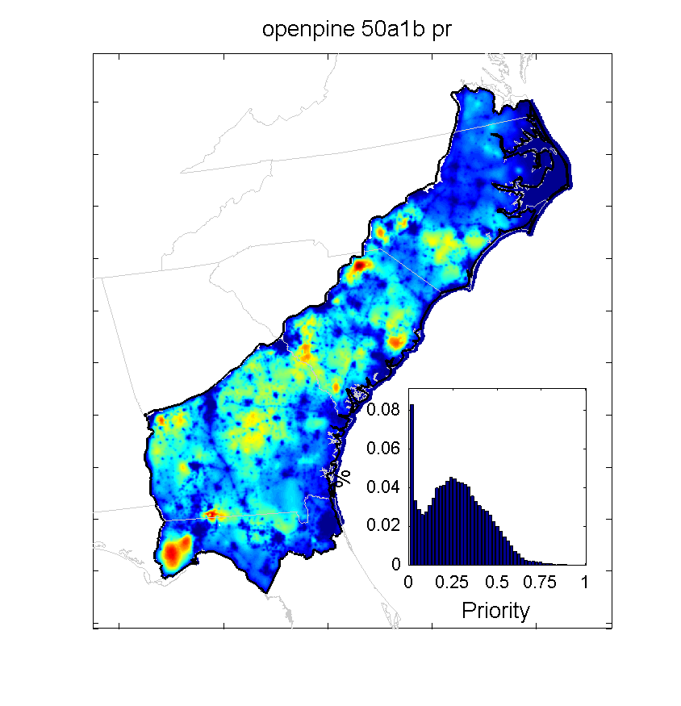
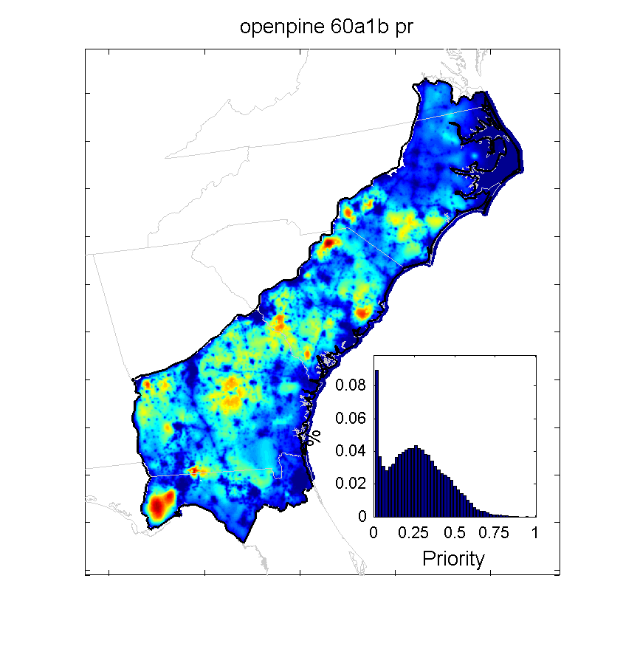
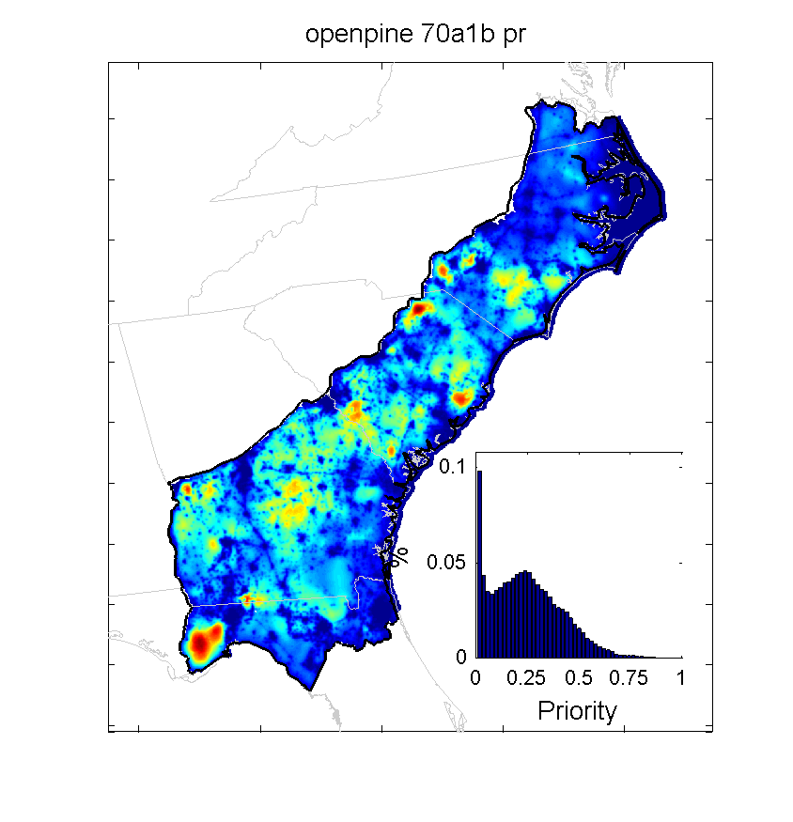
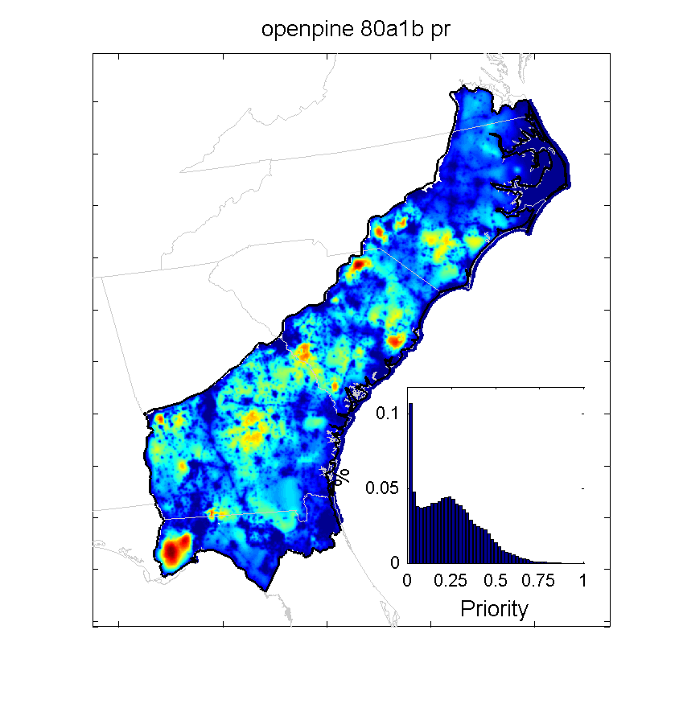


Temporal dynamics

Slide 24
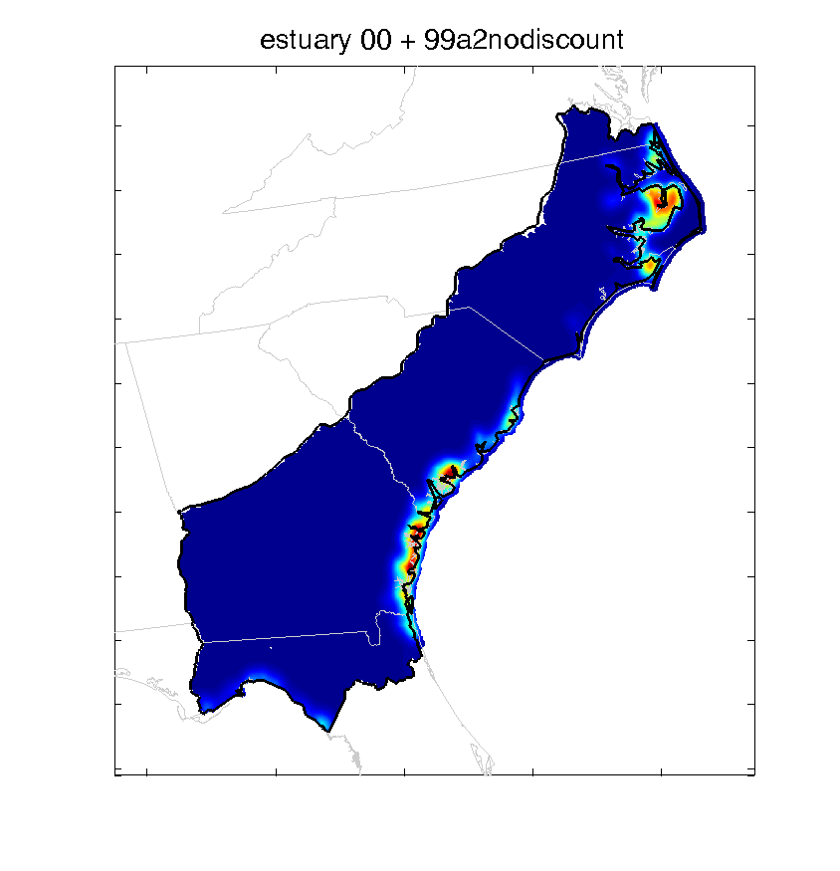
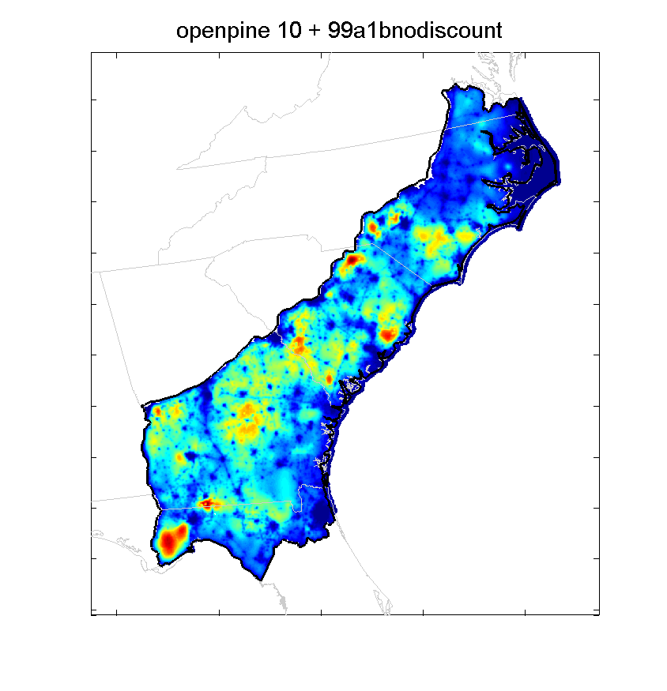
Integrating temporal dynamics

Slide 25
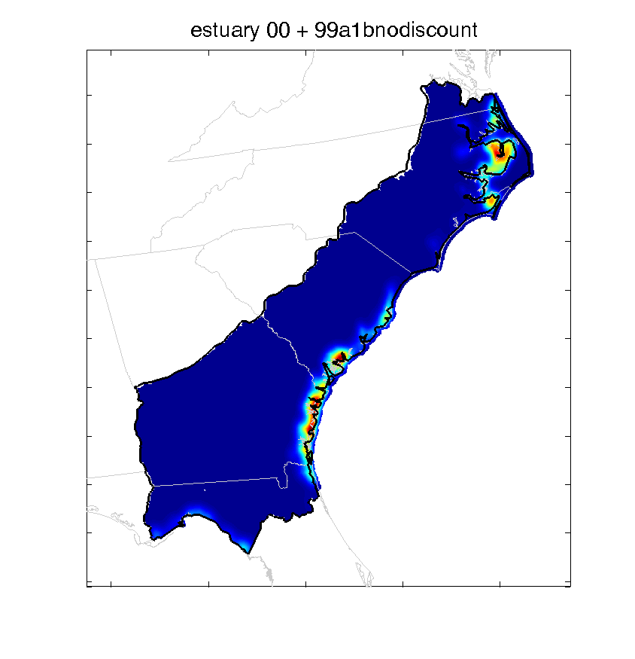

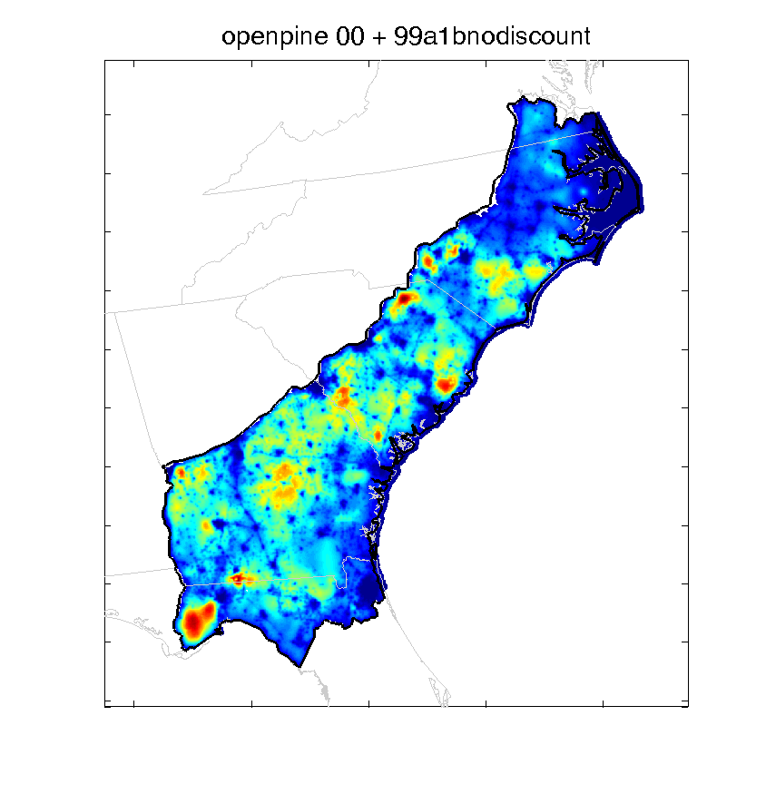


Comparing emission scenarios

Slide 26
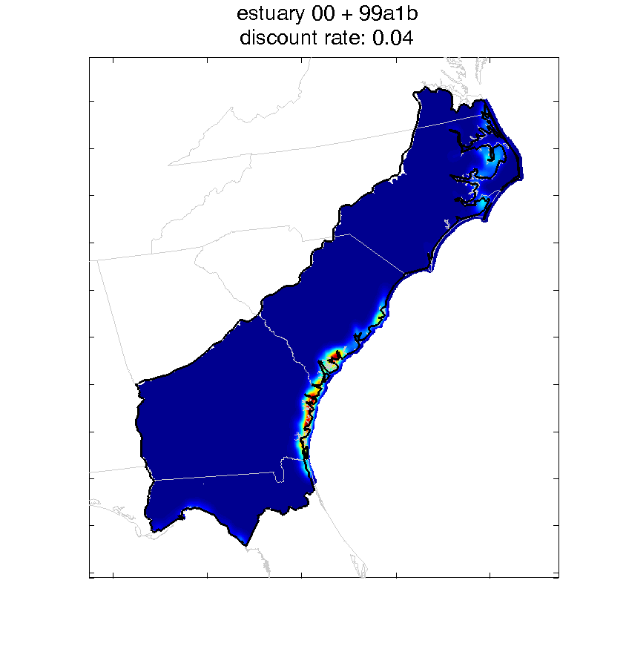

Discounting future scenarios

Slide 27
Focal species values
Alluvial forested wetlands | How well did the species work as a focal species within the habitat? |  |  |  |  | Weighted value
Species | Very poorly (1) | Poorly (2) | Neutral (3) | Well (4) | Very well (5)
Prothonotary warbler | 0 | 0 | 0 | 1 | 10 | 3.3
Swainson's warbler | 0 | 1 | 1 | 2 | 7 | 3.0
Yellow-throated warbler | 0 | 1 | 0 | 5 | 5 | 2.9
Wood duck | 0 | 1 | 2 | 1 | 7 | 2.9
Swallow-tailed kite | 0 | 1 | 2 | 1 | 5 | 2.6
Cerulean warbler | 2 | 1 | 3 | 4 | 1 | 2.1
Black-throated green warbler | 2 | 1 | 4 | 3 | 1 | 2.0
Mallard | 2 | 1 | 3 | 3 | 0 | 1.8

Slide 28
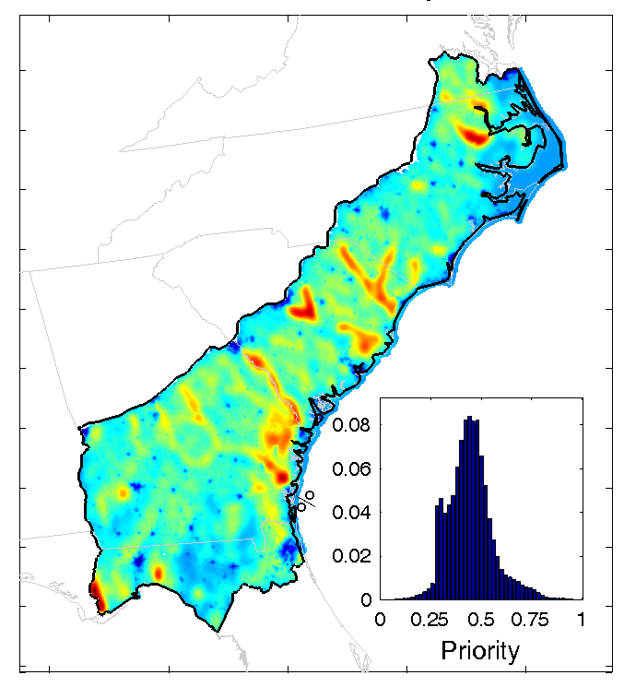
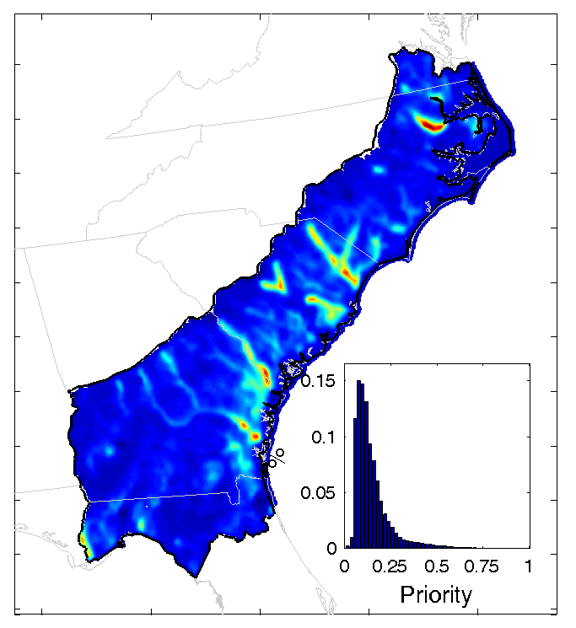
Alluvial forested wetlands
No Focal Species
Focal Species Equal Weights
Weighted Focal Species
(a) vegetation density
(b) focal species
(c) focal species value
Notes:
(a) is using vegetation type density
(b) using focal species
(c) using focal species values

Slide 29
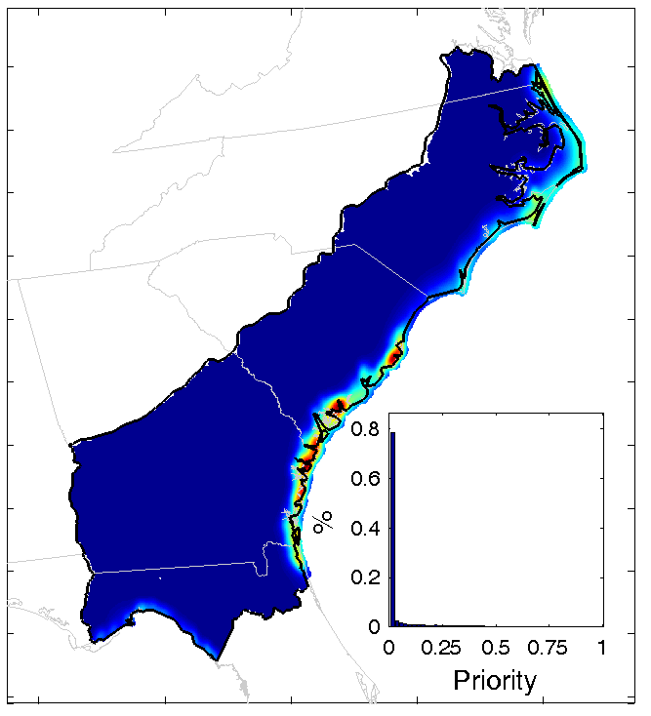
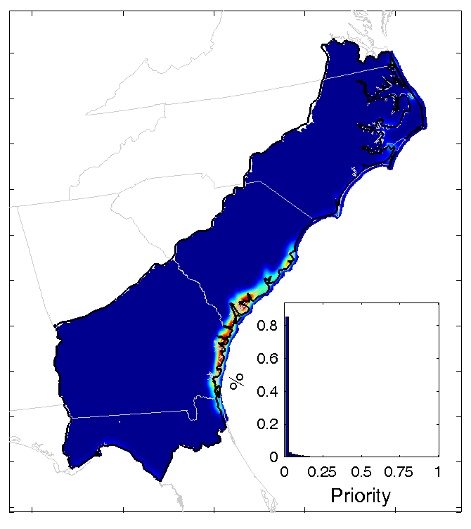
No Focal Species
Focal Species Equal Weights
Weighted Focal Species
(a)
(b)
(c)
Beach

Slide 30

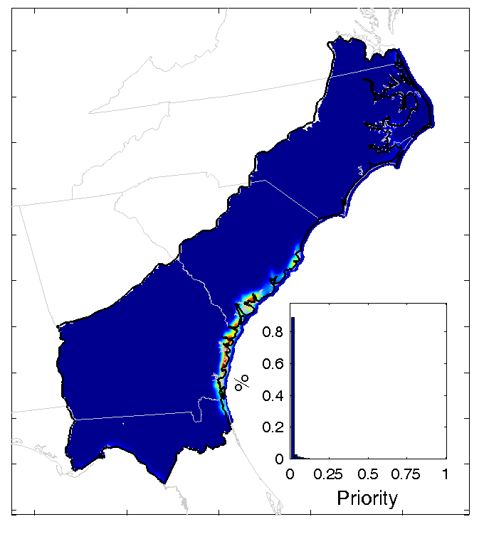
Estuarine wetlands
No Focal Species
Focal Species Equal Weights
Weighted Focal Species
(a)
(b)
(c)

Slide 31
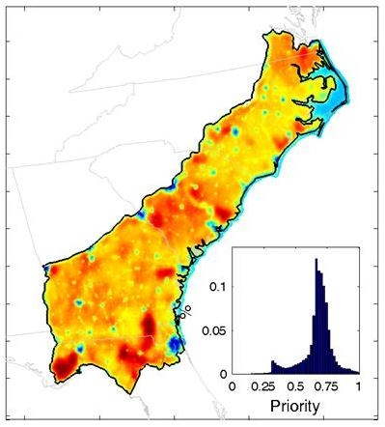
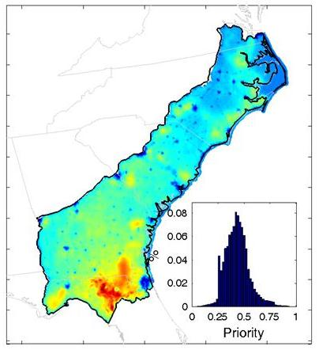
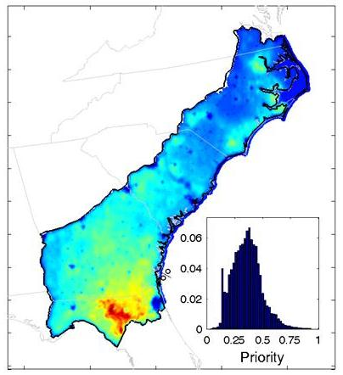
Grassland
No Focal Species
Focal Species Equal Weights
Weighted Focal Species
(a)
(b)
(c)

Slide 32
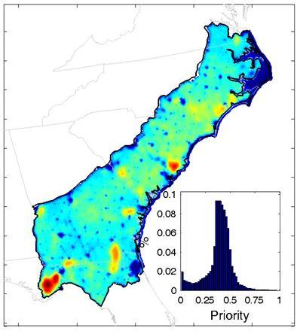
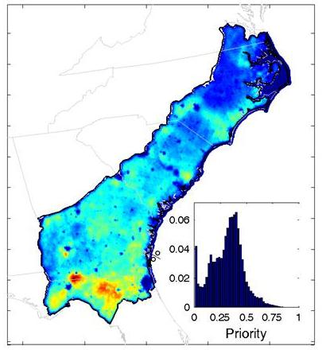
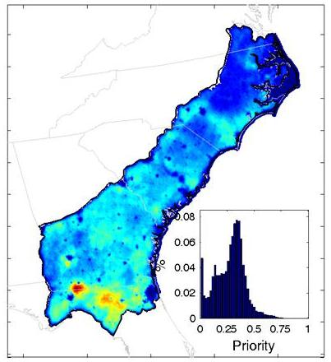
Longleaf
No Focal Species
Focal Species Equal Weights
Weighted Focal Species

Slide 33
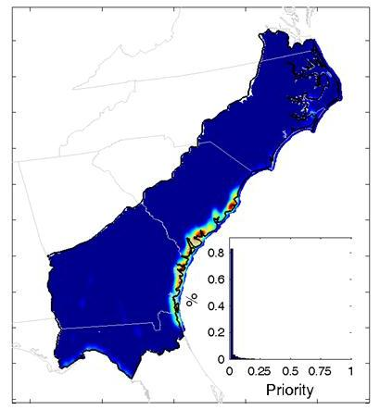
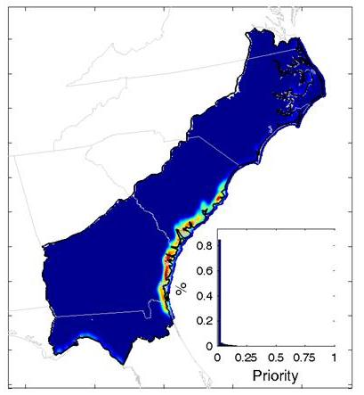
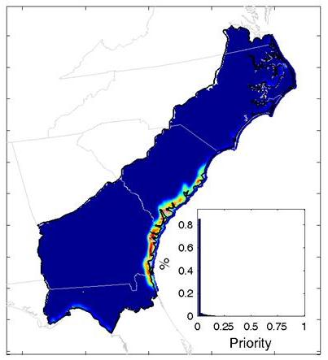
Maritime forest
No Focal Species
Focal Species Equal Weights
Weighted Focal Species
(a)
(b)
(c)

Slide 34



Non-alluvial forested wetland
No Focal Species
Focal Species Equal Weights
Weighted Focal Species
(a)
(b)
(c)

Slide 35



Open pine
No Focal Species
Focal Species Equal Weights
Weighted Focal Species
(a)
(b)
(c)

Slide 36



Scrub
No Focal Species
Focal Species Equal Weights
Weighted Focal Species
(a)
(b)
(c)

Slide 37



Slope forest
No Focal Species
Focal Species Equal Weights
Weighted Focal Species
(a)
(b)
(c)

Slide 38



Upland forest
No Focal Species
Focal Species Equal Weights
Weighted Focal Species
(a)
(b)
(c)

Slide 39



Wetland
No Focal Species
Focal Species Equal Weights
Weighted Focal Species
(a)
(b)
(c)

Slide 40
Selecting focal areas

Slide 41
Approach
Determine area required to meet SAMBI population objectives
Use published home ranges or densities
Multiplied by population objective
Delineate 5 sites from highest priority in each habitat
What about conflicts?

Slide 42
Conflicts
Start with highest ranking habitat
Delineate highest priority area
Mask focal area
Select next habitat
How to rank habitats?

Slide 43
Priority alternatives
Rarity of habitat in SAMBI
Rarity of habitat in SAMBI by state
Number of imperiled species
Most imperiled species
Historic extent
Notes:
we developed four different ways to select among the habitats
based on the total amount of the habitat in the SE – so habitats with little area were given priority
based on the total amount of the habitat in each state – in this case, we were ensuring that each state had each habitat; I’m only going to show the results for NC
based on the number of imperiled species in each habitat
based on the most imperiled species – so for example, the Red-cockaded woodpecker is the most imperiled species so habitats that it uses – longleaf and mature open pine – are of highest ranking
5) based on historic extents

Slide 44
Ranking habitats
 | Alternative ranking
Habitat | 1 | 2 | 3 | 4 | 5
Alluvial forested wetland | 12 | 11 | 6 | 5 | 4
Beach | 1 | 3 | 2 | 11 | 2
Estuary | 5 | 5 | 7 | 3 | 3
Grassland | 7 | 7 | 10 | 8
Longleaf and associated | 11 | 12 | 5 | 1 | 1
Maritime forest | 4 | 4 | 4 | 4 | 7
Non-alluvial forested wetland | 9 | 8 | 3 | 10 | 5
Mature open pine | 6 | 10 | 11 | 2
Shrub scrub | 10 | 6 | 9 | 9
Slope forest | 3 | 2 | 8 | 6 | 7
Upland forest | 8 | 9 | 12 | 7 | 8
Freshwater wetland | 2 | 1 | 1 | 12
Notes:
Scenario 2 is for South Carolina

Slide 45

Comparison of alternatives - 1

Slide 46

Comparison of alternatives - 2

Slide 47

Comparison of alternatives - 3

Slide 48

Comparison of alternatives - 4

Slide 49

Comparison of alternatives - 5

Slide 50











Input from ACJV
What is most important?
Rarity
Species?
Habitat?
Cost?
States?

Slide 51
Availability & application of data

Slide 52
Project Web site – publications
NCSU
Sea Level Rise Modeling for the SAMBI DSL Project (PDF)
Urban Modeling for the SAMBI DSL Project (PDF)
Landscape Succession Modeling for the SAMBI DSL Project (PDF)
Avian Habitat Modeling for the SAMBI DSL Project (PDF)
Occupancy Models and Strategic Habitat Conservation for Avian Species in the Southeastern Coastal Plain of the United States (Monica Iglecia MS Thesis)
Auburn
Moody Dissertation
Incorporating Expert Knowledge in Decision-Support Models for Avian Conservation
Moody, A.T., and J.B. Grand. 2012. Incorporating Expert Knowledge in Decision-Support Models for Avian Conservation in A.H. Perera et al. (eds.), Expert Knowledge and Its Application in Landscape Ecology. Springer.
Focal species as method to plan spatially explicit conservation priorities. (June 2012)
Conservation priorities in an uncertain future (June 2012)

Slide 53
Project web site – GIS Data
Sea Level Rise (44 data layers)
SLAMM Output for SAMBI DSL Utilizing A1B Emission Scenario, Decadal Predictions 2000-2100 (ESRI GRID)
SLAMM Output for SAMBI DSL Utilizing A1FI Emission Scenario, Decadal Predictions 2000-2100 (ESRI GRID)
SLAMM Output for SAMBI DSL Utilizing A2 Emission Scenario, Decadal Predictions 2000-2100 (ESRI GRID)
SLAMM Output for SAMBI DSL Utilizing B1 Emission Scenario, Decadal Predictions 2000-2100 (ESRI GRID)
Urban Growth (11 data layers)
SLEUTH Output for SAMBI DSL, Decadal Predictions 2000-2100 (ESRI GRID)

Slide 54
Project web site – GIS Data
Landscape Succession with Sea Level Rise and Urban Growth (33 data layers)
VDDT/TELSA Output for SAMBI DSL Utilizing A1B Emission Scenario, Decadal Predictions 2000-2100 (ESRI GRID)
VDDT/TELSA Output for SAMBI DSL Utilizing A2 Emission Scenario, Decadal Predictions 2000-2100 (ESRI GRID)
VDDT/TELSA Output for SAMBI DSL Utilizing B1 Emission Scenario, Decadal Predictions 2000-2100 (ESRI GRID)

Slide 55
Project web site -- GIS Data
Species Habitat Models (1,320 data layers)
Avian Habitat Models for SAMBI DSL Utilizing A1B, A2 and B1 Emission Scenarios, Decadal Predictions 2000-2100 (ESRI GRID)
Priority maps
Priority surface for each habitat, decade, and Emission Scenario (396 layers) (ArcASCII)
Integrated priority surfaces for each habitat, Emission Scenario, discount rate (72 layers) (ArcASCII)
Focal areas for each Emission Scenario and Alternative (15 layers) (Shapefile)

Slide 56
Using priority surfaces
Applications of Open Pine DST (similar)
NFWF projects within the EGCP JV
Landowner Incentive Program Projects in Alabama
Partners for Fish & Wildlife Conservation Projects in Alabama
Web Application – coming soon

Slide 57

Range-wide Open Pine DST
Incorporating bird (wildlife) responses
Direct link to population objectives
Spatially explicit population predictions
Direct link to Desired Forest Conditions
Preferred conservation actions
Which actions?
At what cost?
When?

Slide 58
Conceptual Decision Model
What will provide the greatest value given the current conditions?
Current conditions – habitat, bird populations
Value ← max(bird populations), min(cost)

Slide 59
Optimal Conservation Strategies
Related Project

Slide 60
LCC Objectives Hierarchy Optimal Conservation Strategy workshop (May 3 – 5, 2011)
Maximize Value
Cultural resources
Socio-economic resources
Sites
Objects
Biotic cultural resources
Recreation
Human health
Economy
Natural resources
Ecological systems
Viability of T&E species
Notes:
These are the objectives and sub-objectives elicited from the working group at the workshop in Auburn. In this prototype we’ve only included a subset of the objectives outlined in red, but we’ve amassed the data to incorporate several more, outlined in blue.
Cultural resources – These resources are ethnographic; that is, they have a relationship to what people do on the landscape. Examples include huntable and fishable populations of animals, access to public lands, archeological sites and objects. The measurable attributes of these resources are the number, representation of cultures, and value as defined by NPS and other stakeholders.
Socioeconomic resources – These directly affect quality of life for humans and may contribute to their livelihood and health. Examples include the economic impacts of commercial fishing and timbering as well as influences of these activities on human health and environmental justice. The measurable attributes here are related to economic cost-benefits and human health (e.g. risk of exposure).
Natural resources – These resources are based on the integrity of ecological systems that characterize natural areas and managed landscapes that people care about. Fish and wildlife populations are both products and indicators of the integrity of systems. Integrity is measured as the degree to which the structure and composition of fish, wildlife, and plant populations meet historical levels, and in some cases (TES) the long-term viability of populations.

Slide 61

Actions & Strategies & Decisions
What?
What action?
When?
Does timing matter?
Where?
Does location matter?
How much?
What can we afford?
How much is enough?
Action – what we do for conservation (tactic)
Strategy – where, when, and how much we do
Decision – choose a strategy & portfolio of actions
Notes:
To develop this problem we first need some specifics answers to a basic set of questions

Slide 62










Modeling Consequences
Predicting outcomes based on objectives
Ecosystem integrity
Socio-economic
Cultural value
Scope
South Atlantic Coastal Plain
Scale
NHD catchment (n ~ 115,500)
Dynamics
Urban growth
Sea level rise
Vegetative succession
Notes:
We developed a model to predict the consequences of the alternatives on each objective.
The model operates at the scope of the Coastal Plain within the bounds of the SA LCC
We used NHD catchments as the units upon which the alternatives are implemented.
Catchments circumscribe stream reaches and include the adjacent land cover, so they provide a functional tie between terrestrial and aquatic systems
There are approximately 115,500 of them in the study area
We used a model of landscape dynamics developed at NCSU with funding from USFWS and USGS
They modeled urbanization using one parameterization of SLEUTH
They used SLAMM to predict sea level rise
Their vegetative model predicts change for several hundred land cover classes under 3 climate scenarios from 2000-2100
For the prototype
We simplified the land cover to 23 classes and calculated rates of change between classes from their predictions
We used only 1 climate scenario (A1B)
The animation is a depiction of change in our simplified re-classification for their A1B scenario for a region on the North Carolina coast.
Dark red is urban
Med. Dark Blue is tidal marsh

Slide 63
Approach
Project landscape for 50 yrs under each alternative
Estimate cost of implementation
Calculate value (each objective)
Select sites w/greatest marginal values until budget exhausted
Iterate

Slide 64
Ecosystem integrity - priority species
Fish
Herbivores
Native Invertivore
Native Invert-/Piscivore
Non-Lithophilic Nest Guarders (Comp)
Non-Lithophilic Nest Guarders (Spp)
Ominvores (Comp)
Birds
Wood Duck
Least Bittern
American Oystercatcher
Swallow-tailed Kite
Acadian Flycatcher
Seaside Sparrow
Painted Bunting
Loggerhead Shrike
Prothonotary Warbler
Prairie Warbler
Hooded Warbler
Brown-headed Nuthatch
Herps
Barking Treefrog
Coachwhip
Diamondback Terrapin
Eastern Glass Lizard
Eastern Narrowmouth Toad
Fence/prairie/plateau Lizard
Slender Glass Lizard
Greater Siren
Loggerhead
Marbled Salamander
Ornate Chorus Frog
Pine Woods Treefrog
Six-lined Racerunner
Southern Chorus Frog
Southern Leopard Frog
Spotted Salamander
Spotted Turtle
Notes:
We used predicted responses from priority species as indicators of ecosystem integrity
Fish – based on work by Dana Infante at MSU using NFHAP data to predict status of populations for 6 guilds of fish
Responses are based on thresholds of watershed disturbance
These groups are used in assessments by EPA
Birds – Priority species for 12 habitats from Atlantic Coast JV
Response based on an analysis of relationships between land cover and abundance on Breeding Bird Surveys
Herps – (not included in this iteration) Priority species from SE Partners in Amphibian and Reptile conservation
Response based on potential habitat (SE GAP models).
We have the data and the models –these are computationally expensive and we need to seek some more efficient modeling approaches

Slide 65




Marginal value – aquatic taxa
Status quo (Alternative 1)
Business as usual
Landscape is still dynamic
Restore open pine (Alternative 2)
Everywhere
Marginal value
Difference
Places where there is an effect
High
Low
Notes:
We use marginal value to indicate locations where we can have the greatest effect through conservation.
Remember the 2 alternatives. The first image is the same one we just saw. This is the cumulative status of fish population under the status quo alternative. The second image is the status if we converted 80% of the ag in every catchment to open pine. The third image is marginal value—the difference between the two models. Warmer colors indicate the greatest gains in fish populations. The take home message here is that there aren’t that many places where we would expect large gains in populations – makes this a good illustration of why we use marginal value and not just the estimate of population status to decide where we should spend our efforts.

Slide 66



Marginal value - birds
Status quo (Alternative 1)
Do nothing
Landscape is still dynamic
Restore open pine (Alternative 2)
Everywhere
Marginal value
Difference
Places where there is an effect
High
Low
Notes:
We conducted the same analysis for bird populations based on all 12 species.

Slide 67

Ecosystem integrity - priority species
Fish
Herbivores
Native Invertivore
Native Invert/Piscivore
Non-Lithophilic Nest Guarders (Comp)
Non-Lithophilic Nest Guarders (Spp)
Ominvores (Comp)
Birds
Wood Duck
Least Bittern
American Oystercatcher
Swallow-tailed Kite
Acadian Flycatcher
Seaside Sparrow
Painted Bunting
Loggerhead Shrike
Prothonotary Warbler
Prairie Warbler
Hooded Warbler
Brown-headed Nuthatch
Herps
Barking Treefrog
Coachwhip
Diamondback Terrapin
Eastern Glass Lizard
Eastern Narrowmouth Toad
Fence/prairie/plateau Lizard
Slender Glass Lizard
Greater Siren
Loggerhead
Marbled Salamander
Ornate Chorus Frog
Pine Woods Treefrog
Six-lined Racerunner
Southern Chorus Frog
Southern Leopard Frog
Spotted Salamander
Spotted Turtle
High
Low
Notes:
We then average the scores for the taxa groups and re-scale them to determine where we get the best responses from fish and birds to our conservation strategy.

Slide 68



Socioeconomic values
Integrates dynamics
Water quality
Agriculture
Urban
Early successional
Production value
High
Low
Notes:
As an example of how we can add additional objectives to the analysis, we developed a relatively simple model of water quality based on a linear function of the Σ% urban, agricultural, and early successional land cover in the catchment. Our assumption is that water quality will be lower in catchments and networks where disturbance is greater. Could just as easily include the composition in the catchments upstream as in the fish models.
We calculate this index for the status quo landscape (graphic 1), the landscape where 80% of ag in each catchment is converted to open pine (graphic 2), and the marginal (difference) (graphic 3). Again the warmer colors indicate areas where our alternative has the greatest benefit.
We have the ability and the data to also include the cost of removing land from production (i.e., agriculture or forestry) as an impact on socioeconomic values.

Slide 69

Overall value (utility)
High
Low
Notes:
The marginal values for Ecological systems (fish and birds) and Socio-economics (H20 quality) are averaged and re-scaled to provide a map of the overall value of the conservation Alternative across both of the objectives.
The value of the Alternative is the sum of the values over the entire landscape and provides a single metric that can be used to compare the Alternatives.
I should note here that we need to incorporate uncertainty as a ‘smoothing’ parameter on each of these value functions to calculate a true utility value for the alternatives.

Slide 70

























Including costs - budget limitation
High
Simple approach
Cost α acres restored
Highest marginal value
Dynamic
Start with highest value and spend to annual budget limit
Low

