Slide 1
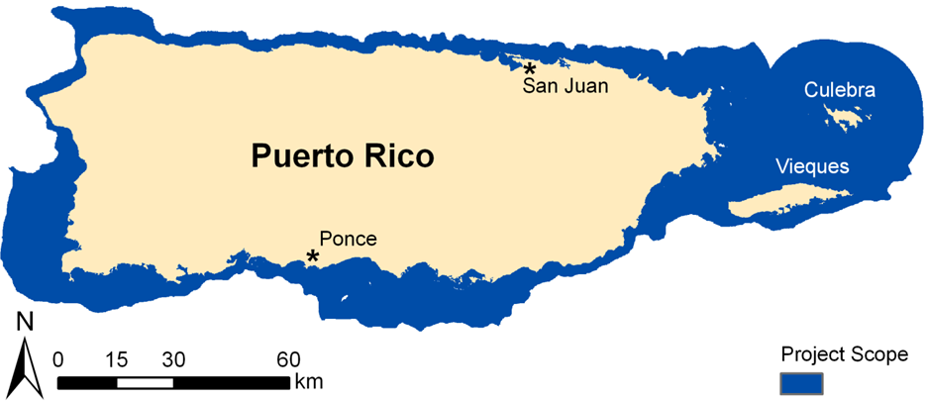
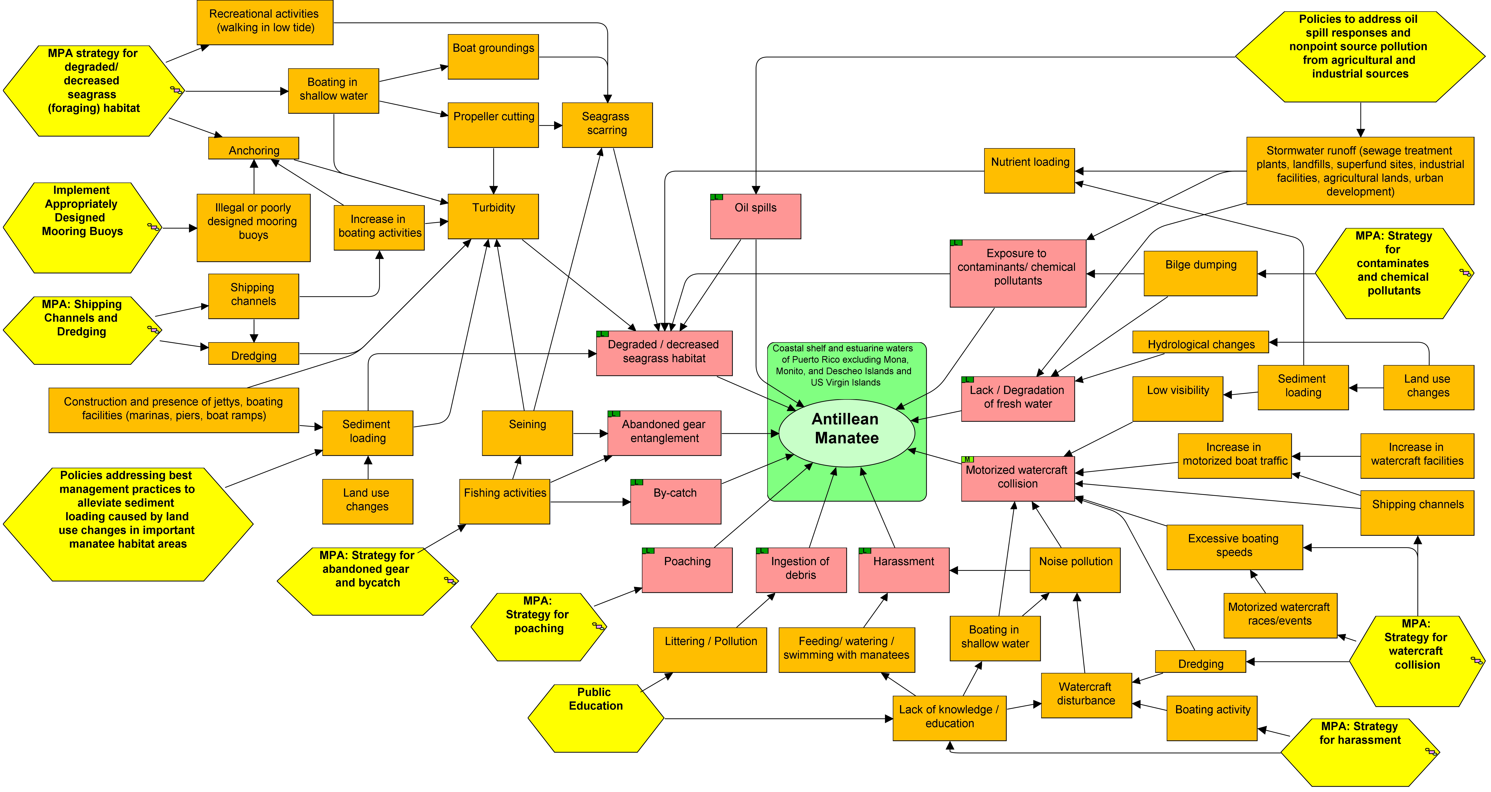
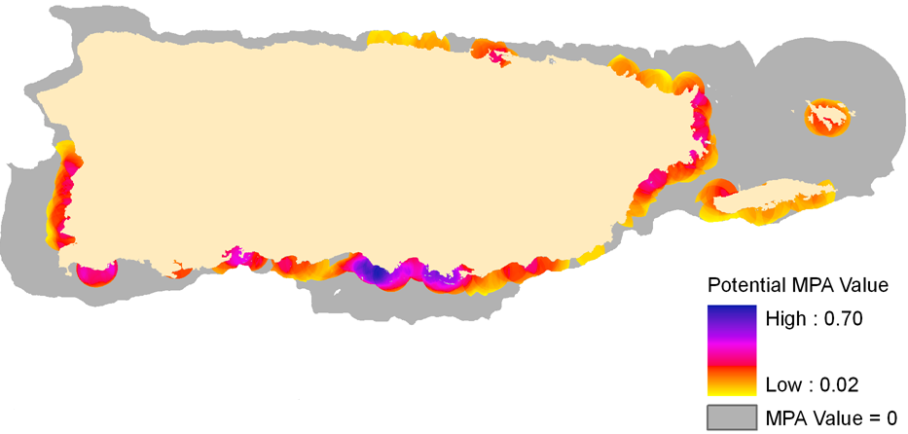
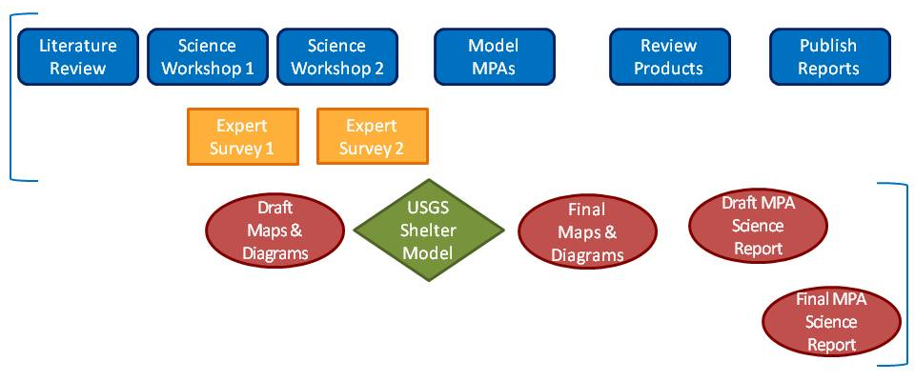
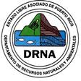
A structured approach to designing protection areas for the Antillean manatee in Puerto Rico
Louise Alexander¹, C. Ashton Drew¹, and Jaime Collazo²
¹Environmental Decision Analysis Team, Department of Biology, NC State University, Raleigh, North Carolina, USA
²USGS North Carolina Cooperative Fish and Wildlife Research Unit, Department of Biology, NC State University, Raleigh, North Carolina, USA
Introduction
Little was known about the Antillean manatees (Trichechus manatus manatus) occurring in Puerto Rico when listed as a federally endangered species in 1986.
The efforts of the US Fish and Wildlife Service and the Puerto Rico Department of Natural and Environmental Resources to implement various recovery activities have provided new data and insights regarding the manatee population of Puerto Rico.
We used the Open Standards for the Practice of Conservation framework to organize new data and to elicit expert knowledge for the purposes updating the recovery plan and to assist in the design of manatee protected areas.
Methods
1. Review of literature and data (aerial survey counts of manatees, coastal bathymetry and benthic habitat, reports of manatee strandings, freshwater sources, and presence of boating activity).
2. We used the Open Standards to develop elicitation questions to guide data collection during two workshops and to administer surveys to identify threats to manatees and their habitat as well as potential strategies to alleviate those threats.
3. We generated spatial models of key ecological attribute resource values and presence of threats. Areas with high values for both resources and threats were proposed as potential Manatee Protected Areas (MPAs).
Results
Using elicitation responses, we identified a scope (Figure 2), vision, and key ecological attributes for the conservation target (Antillean manatee), as well as create a conceptual diagram (Figure 3). We also identified threats to manatees and their habitat, as well as potential conservation strategies.
Conclusions
Our model represents experts’ hypotheses regarding manatee requirements and threats.
This regional valuation approach clearly articulates assumptions about manatee ecology and anthropogenic threats.
Potential MPA regions or those areas with the greatest potential to reduce take and offer habitat resources necessary to attract and support manatees.
Recommendations
Spatial data were limited when translating knowledge to a spatial model framework. Weaknesses within the spatial data resources likely introduced error at specific locations around Puerto Rico. Next steps should include site visits to validate resource presence and quality, as well as assess local threats and the political, social, and economic feasibility of each site.
MPA success can be measured in terms of positive changes in watercraft activity (boater behavior) and demographic parameters of manatees. As shown in the conceptual diagram (Figure 2), experts identified multiple threats to manatees, not all of which can be addressed by MPAs.
MPAs should be one of several, coordinated recovery strategies recommended in the revised Recovery Plan and shown in the conceptual diagram.
Acknowledgments
We thank the USGS Sirenia Project, the USFWS Caribbean Field Office, Puerto Rico Department of Natural and Environmental Resources , and the Caribbean Stranding Network.
 |  |  | Boats |  |  | Freshwater |  |  | Seagrass |  |  | Shelter
 | MPA Value |  | Data Pts in Region | Value* |  | Data Pts in Region | Value* |  | Area in Region | Value* |  | Area in Region | Value*
 |  |  |  |  |  |  |  |  |  |  |  |  | Mean | SD
Region Name | Mean | SD |  | Mean | SD |  | Mean | SD |  | Mean | SD
1. Santa Isabel to Bahía de Jobos | 0.453 | 0.104 | 41 | 0.387 | 0.141 | 24 | 0.467 | 0.185 | 46 | 0.420 | 0.239 | 82.7 | 0.713 | 0.162
2. Guayanilla and Tallaboa | 0.361 | 0.040 | 4 | 0.197 | 0.047 | 6 | 0.415 | 0.095 | 5.7 | 0.292 | 0.035 | 20.8 | 0.747 | 0.071
3. Roosevelt Roads | 0.327 | 0.027 | 1 | 0.150 | 0.033 | 0 | 0.439 | 0.040 | 1.4 | 0.384 | 0.050 | 4.0 | 0.464 | 0.012
4. Punta Molino to Isla Cueva | 0.323 | 0.031 | 6 | 0.250 | 0.092 | 4 | 0.238 | 0.028 | 19.6 | 0.631 | 0.126 | 9.1 | 0.318 | 0.067
5. Puerto Medio Mundo | 0.322 | 0.027 | 1 | 0.231 | 0.034 | 2 | 0.502 | 0.049 | 3.3 | 0.335 | 0.042 | 2.1 | 0.286 | 0.058
6. Las Croabas | 0.318 | 0.019 | 7 | 0.749 | 0.071 | 0 | 0.168 | 0.029 | 0.3 | 0.143 | 0.024 | 1.9 | 0.590 | 0.079
7. Mayagüez | 0.306 | 0.012 | 4 | 0.544 | 0.027 | 1 | 0.571 | 0.039 | 1.5 | 0.605 | 0.079 | 0.2 | 0.047 | 0.004
8. Punta Santiago | 0.303 | 0.017 | 3 | 0.244 | 0.042 | 3 | 0.359 | 0.060 | 5.6 | 0.291 | 0.050 | 7.3 | 0.345 | 0.034
9. Boquerón | 0.299 | 0.011 | 0 | 0.544 | 0.037 | 2 | 0.517 | 0.044 | 0.9 | 0.277 | 0.018 | 0.5 | 0.103 | 0.010
10. Arroyo | 0.294 | 0.007 | 0 | 0.297 | 0.022 | 0 | 0.282 | 0.030 | 2.2 | 0.352 | 0.015 | 0.6 | 0.255 | 0.015
11. Bahía Demajagua | 0.293 | 0.007 | 0 | 0.358 | 0.031 | 0 | 0.529 | 0.044 | 0 | 0.243 | 0.019 | 0 | 0.162 | 0.012
12. Bahía de San Juan | 0.291 | 0.006 | 5 | 0.965 | 0.017 | 0 | 0.585 | 0.049 | 0 | 0.020 | 0.000 | 2.9 | 0.639 | 0.025
Figure 2. Experts identified the project scope as the coastal shelf and estuarine waters of Puerto Rico excluding Mona, Monito, Desecheo Islands, and the US Virgin Islands. The vision for this region is the long term conservation and recovery of the endangered Antillean Manatee and its habitats in coastal and estuarine waters in Puerto Rico.
Figure 3. Concept Diagram depicting target (green oval), direct threats (pink rectangles), indirect threats (orange rectangles), and MPA strategies (yellow hexagons).
KEA Map Data
Key ecological attributes (KEAs) are biological characteristics, resources or elements required by a conservation target for success. Expert elicitation workshops result in three key ecological attributes: Seagrass, freshwater, and shelter. Below are the spatial data layers generated to depict key ecological attributes and threats.
KEA Resource Value Data
Experts indicated potential MPA sites include access to all key ecological attributes within 5 km. To calculate the potential MPA value of a site we calculated the geometric mean of the four MPA variables (three key ecological attributes and one threat). Each variable was scaled relative to the maximum value for that variable within the project scope, such that values range from 0 to 1.
Potential MPAs Value
MPA Value = (Seagrass * Freshwater * Shelter * Watercraft) ^{¼}
The combined values for potential MPAs are presented below . Figure 4 represents the calculated MPA value of coastal waters given the abundance of attributes and watercraft threat within a 5 km radius. Figure 5 represents potential MPA regions with an 80th percentile threshold value. Numbers indicate the regions rank from high to low based on the region’s mean MPA Value.
Table 2. Corresponding potential MPA region name and summary information
Table 1. Common terms and their definitions as used within the Open Standards for the Practice of Conservation and Miradi software (Colors correspond to Figure 3)
Term | Open Standards definitions
Vision | The desired state or condition meant to be achieved by a conservation action, which if achieved would also signify success.
Scope | The thematic focus or geographic area of a project in which to concentrate efforts.
Conservation targets | Specific species, ecological systems/habitats, or ecological processes around which a project is focused.
Direct threats | Events or activities that directly degrade, reduce or destroy a conservation target. We identify three direct threats to nesting habitat and two direct threats to foraging habitat.
Indirect threats | An anthropogenic action or event that underlies or leads to one or more direct threats
Strategy | A term used to describe specific conservation actions designed to restore natural systems, reduce threats, and/or develop capacity.
4.
Source: NOAA (2001)
Source: National Hydrography Dataset (2005),
Autoridad de Acueductos y Alcantarillados, and
Naval Activity Puerto Rico Report (2005)
Major Steps
5.
Products
Source: USGS shelter model
Figure 1. Work flow depicting major steps (blue and orange squares) to gather available data and elicit expert knowledge of manatees in Puerto Rico for the purposes of supporting USFWS Manatee Protected Area site selection and design. Data products and recommendations reflecting best available science appear on right (red ovals and green diamond
Source: NOAA (2005), Travel and Sports Puerto Rico (2010)

